Slide 1

eBay Text Classification and Topic Modeling
University of San Diego
Leonard Littleton, Kiran Singh, Andrew Zazueta

Slide 2

Problem Statement
Web Scrape eBay reviews to build classification models and topic models
Ability to predict whether a customer would leave a positive review (4-5 stars) or negative review (1-3 stars) based off the information in the title of their review
Determine which product the customer was referring to by building a topic model with 5 distinct topics (1 topic for each eBay product scraped)
Classification Models:
Linear SVC
Logistic Regression
KNN
Naive Bayes
Random Forest
SVM
Topic Models:
LSA
LDA
NMF
Figure 1. eBay (1999). [eBay Logo]. Retrieved from https://commons.wikimedia.org/wiki/File:EBay_former_logo.svg

Slide 3
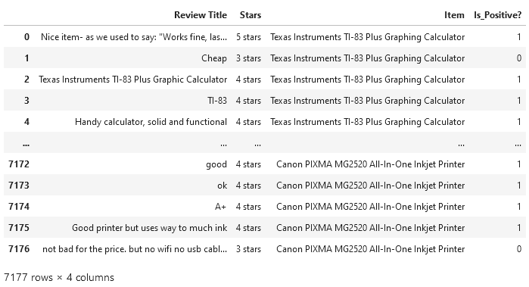
Data Description
Products chosen for text analysis:
TI-83 Plus Graphing Calculator
AirPods
PlayStation 5
LED Tactical Flashlight
Inkjet Printer
BeautifulSoup used for scraping html from eBay
Information pulled:
Review Title
Review Contents
Star Rating
Figure 2. Final Data Frame.

Slide 4
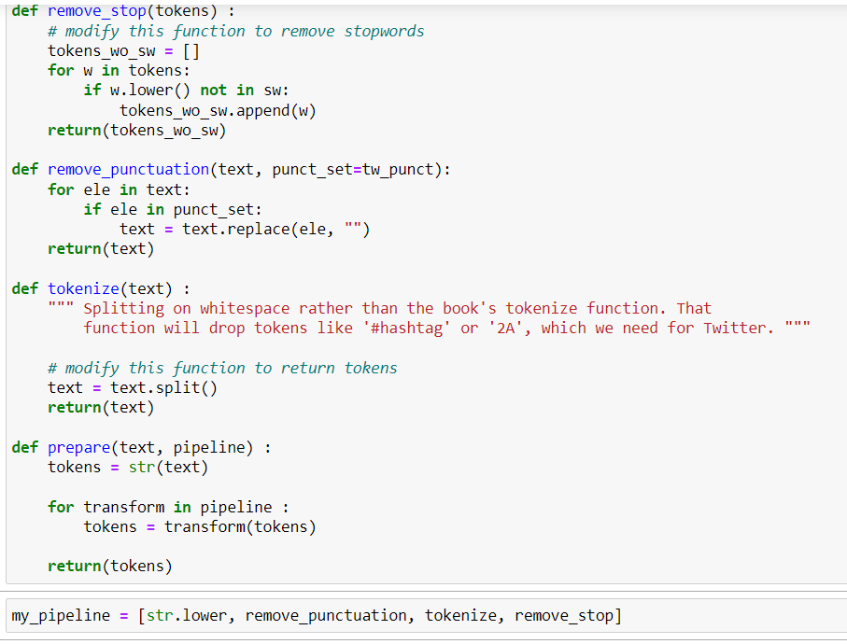
Normalization and Tokenization
Normalization
Convert to lowercase
Remove punctuation
Tokenization
Split by whitespace
Remove stopwords
Figure 3. Normalization and Tokenization steps.

Slide 5
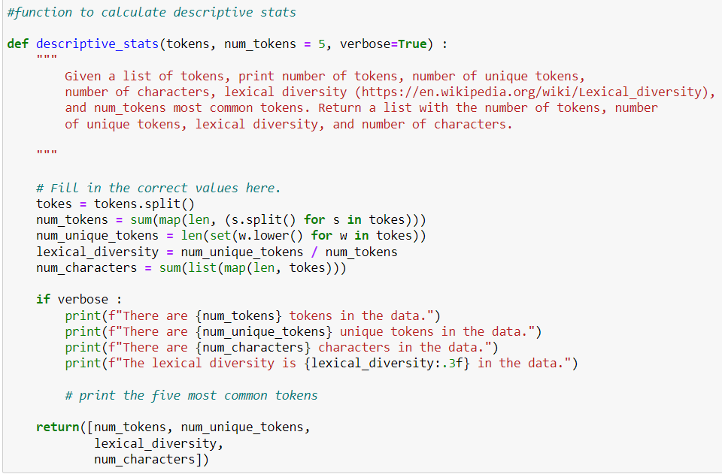
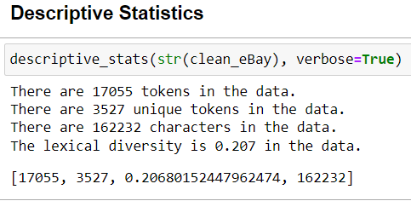
Descriptive Statistics
Number of Tokens
Number of tokens contained within the dataset
Number of Unique Tokens
Number of unique tokens
Lexical Diversity
Ratio of Unique Words to Total Words
Number of Characters
Count of all characters
Figure 4. Descriptive Statistics Method.
Figure 5. Descriptive Stats

Slide 6
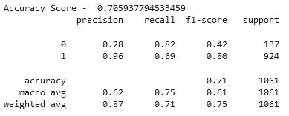
Linear SVC
Linear Support Vector Classifier
Creates hyperplane that divides data for predictive analysis
Hyperparameters modified
Tolerance (10^-5)
Results (Baseline Accuracy- 87.1%)
Figure 6. Linear SVC model statistics.

Slide 7
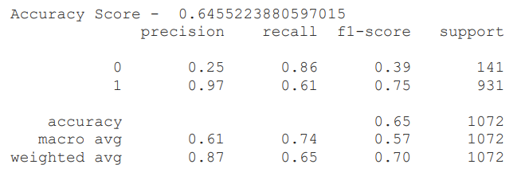
Logistic Regression
Logistic Regression Classifier
S-shaped curve that can take any real-valued number and map it into a value between 0 and 1
Results (Accuracy- 64.55%)
Figure 7. Logistic regression model statistics.

Slide 8
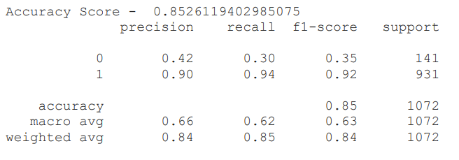
Naïve Bayes
Naïve Bayes Classifier
Used for calculating conditional probabilities.
Results (Accuracy- 85.26%)
Figure 8. Naïve bayes model statistics.

Slide 9
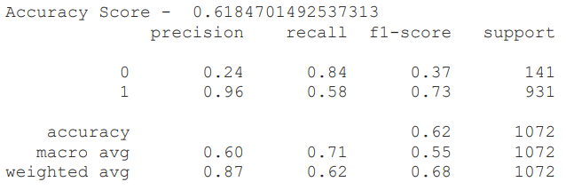
K- Nearest Neighbors
K- Nearest Neighbors is non-parametric, supervised learning classifier
Classify by a plurality vote of its neighbors
K=15
Results (Baseline Accuracy- 61.85%)
Figure 9. K-Nearest Neighbors model statistics.

Slide 10
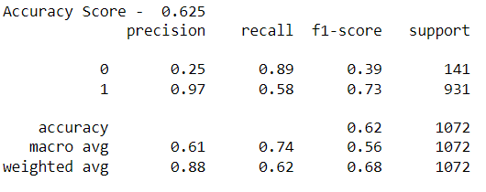
Random Forest
Random Forest Classifier
Combines the output of multiple decision trees to reach a single result.
Hyperparameters modified
Tree Depth (50)
Results (Baseline Accuracy- 87.1%)
Figure 10. Linear SVC model statistics.

Slide 11
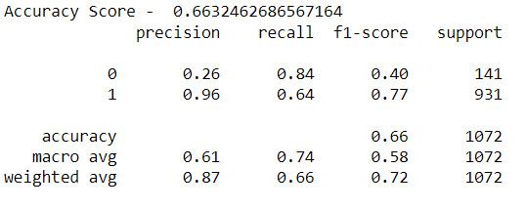
Support Vector Machine (SVM)
Support Vector Machine Classifier
Creates hyperplane that divides data for predictive analysis (Non-Linear)
Hyperparameters modified
Base hyperparameters were used
Results (Baseline Accuracy- 87.1%)
Figure 11. SVM model statistics.

Slide 12
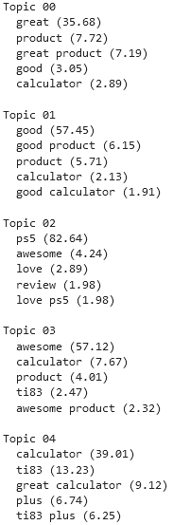
LSA Topic Model
Latent Semantic Analysis
Converts text into matrices
Word-topic
Document-topic
Finds the most optimal matrices to divide topics
Hyperparameters modified
Number of components (5)
Results:
Only two distinct topics (products) were found
PS5 (02)
TI-83 (00, 01, 03, 04)
Figure 12. Model groupings for LSA.

Slide 13
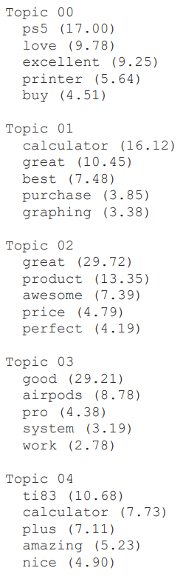
LDA Topic Model
Latent Dirichlet Allocation (LDA)
Converts text into matrices
Word-topic
Document-topic
Finds the most optimal matrices to divide topics
Extract topics from a given corpus
Hyperparameters modified
Number of components (5)
Results:
Four distinct topics (products) were found
PS5 (00)
TI-83 (04)
PRINTER (00)
AIRPODS (03)
Figure 13. Model groupings for LDA.

Slide 14
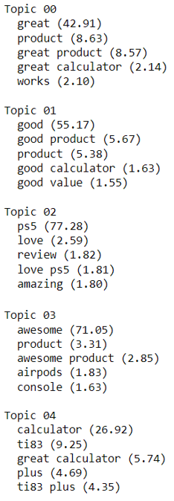
NMF Topic Model
Nonnegative Matrix Factorization
Product of two other nonnegative matrices
W → Document to Topic Matrix
H → Words to Topic Matrix
Multiplication result is the matrix of interest
Hyperparameters modified
Number of components (5)
Results:
Only three distinct topics (products) were found
PS5 (02)
TI-83 (00, 01, 04)
AirPods (03)
Figure 14. Model groupings for NMF.

Slide 15
Model Performance Summary
Model | Precision | Recall | f1-score | Accuracy
Linear SVC | .87 | .65 | .71 | .65
Logistic Regression | .87 | .65 | .70 | .64
Naïve Bayes | .84 | .85 | .84 | .85
K-Nearest Neighbor | .87 | .62 | .68 | .62
Random Forest | .87 | .65 | .71 | .65
Support Vector Machines | .87 | .66 | .72 | .66
Figure 15. Classification Model Performance Summary

Slide 16
Conclusion
Successfully used beautifulsoup to scrape eBay with data like review title, review content and star rating for 5 different products
Executed 6 classification models and 3 topic models
The best classification model is Naïve bayes with accuracy 85% to predict whether a customer would leave a positive review (4-5 stars) or negative review (1-3 stars) based off the information in the title of their review.

Slide 17
Thank you!
Any questions can be directed to the following emails:
leonardlittleton@sandiego.edu
ksingh@sandiego.edu
azazueta@sandiego.edu

Slide 18
References
eBay (1999). [eBay Logo]. Retrieved from https://commons.wikimedia.org/wiki/File:EBay_former_logo.svg

